Slide 1
Date: 09 December 2025

Slide 2
Weekly Presentation : Rotor Bearing System
Week number: 11
Date: 09 /12/2025
Supervisor: Prof. Peter Quell
Group members: Divyesh Mistry, Venkata Sreekanth .K , Sreehari Padachery, Jill Sadariya
Presenter : Divyesh Mistry

Slide 3
Agenda
Bearing Housing.
Shaft.
Bolt calculation for Flange on Hub Side.
Rotor Lock Disc.
Rotor Lock Pin.
Labyrinth Sealing.
Rotor Bearing Assembly.
Cost Calculation(Assumption).
Bibliography.
Divyesh Mistry

Slide 4
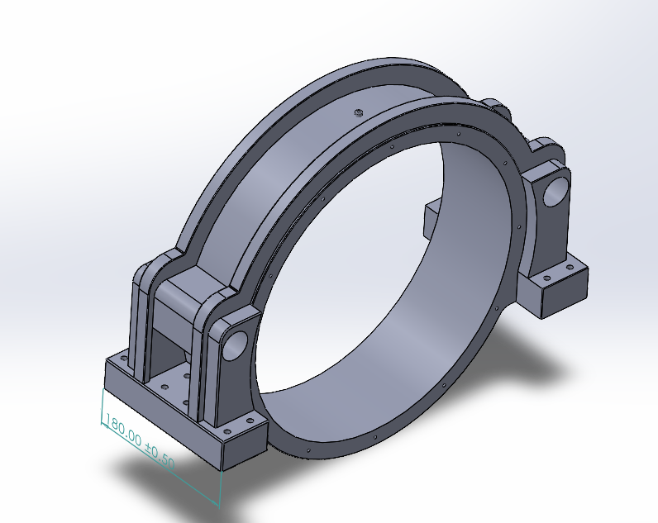
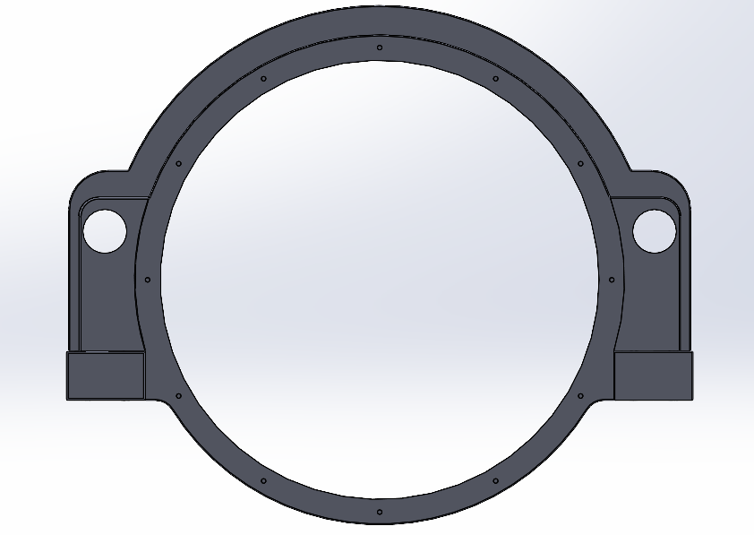
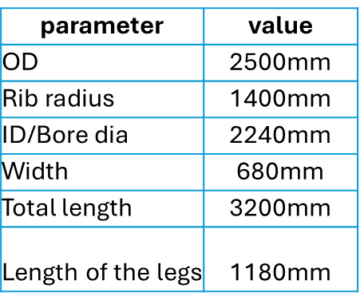
Bearing Housing
M20 bolts
M42 bolts
Divyesh Mistry

Slide 5
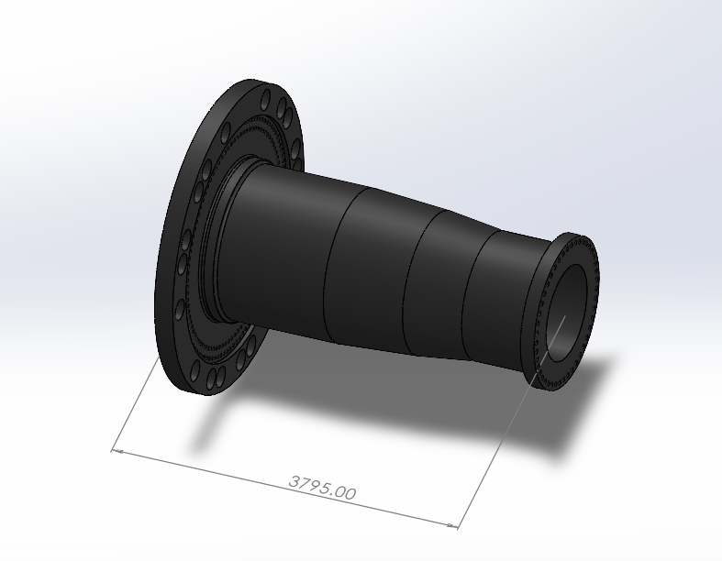
Rotor Shaft
Hub Side Flange
Description | Symbol | Value | Unit
Outer screw circle diameter | dt2 | 2450 | mm
Inner screw circle diameter | dt1 | 2250 | mm
No. of screws per bolt circle diameter | N_{total} = N_{ICB} + N_{OCB} | 94+102=196
Integrated rotorlock Flange outer dia | D_{flange} | 3190 | mm
Gear box Side Flange
Description | Symbol | Value | Unit
screw circle diameter | dt1 | 1464 | mm
No. of screws per bolt circle diameter | N_{total} | 46
Flange outer dia | D_{flange} | 1584 | mm
Divyesh Mistry

Slide 6
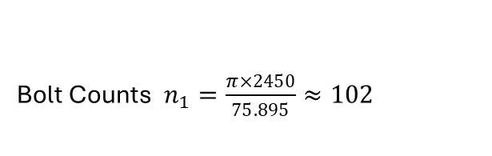
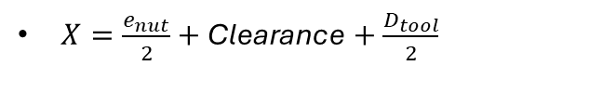
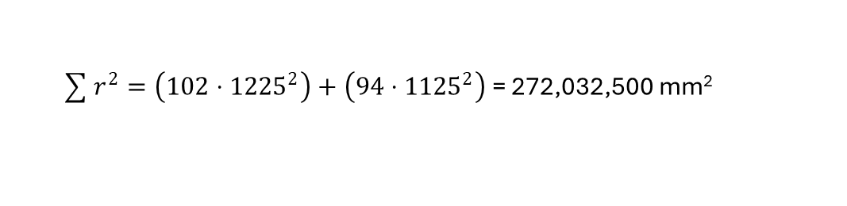
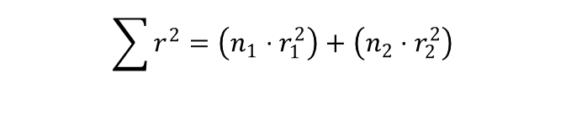
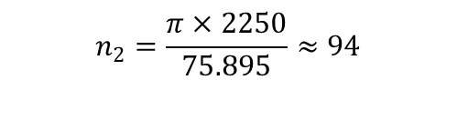
Bolt calculation for the Flange on Hub Side
Applied Torsional Moment: M_{t} = 12800kN·m
Applied Bending Moment (Used for Axial Load): M_{B} = 21573.8 KN.m
$X=\frac{e_{nut}}{2}+\text{Clearance}+\frac{D_{tool}}{2}$
Bolt Counts $n_{1}=\frac{π×2450}{75.895}≈102$
$$n_{2}=\frac{π×2250}{75.895}≈94$$
Outer BCD: 2450mm =⇒ r_{max} = 1225mm
Inner BCD: 2250mm =⇒ r_{min} = 1125mm
Polar Second Moment of Area
$$\sum{r^{2}}=\left(n_{1}⋅r_{1}^{2}\right)+\left(n_{2}⋅r_{2}^{2}\right)$$
$\sum{r^{2}}=\left(102⋅{1225}^{2}\right)+\left(94⋅{1125}^{2}\right)$ = 272,032,500 mm²
Source: Machinery components lectures

Slide 7



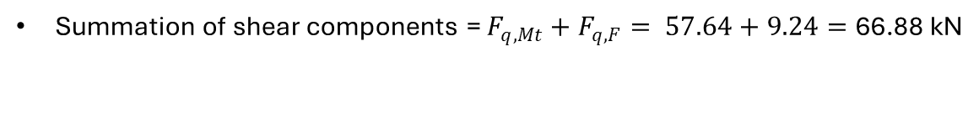
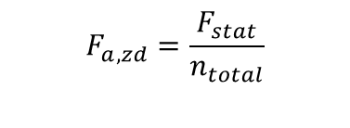
Load due to torque moment
$$F_{q,Mt}=\frac{M_{t}⋅r_{outer}}{\sum{r^{2}}}$$
$F_{q,Mt}=\frac{12800⋅1225}{\text{272,032,500 }\text{mm}\text{2}}$ = 57.64 kN
$$F_{q,F}=\frac{F_{lat}}{n_{total}}$$
$F_{q,F}=\frac{F_{lat}}{n_{total}}$ = 9.24 kN
Load due to lateral force
Summation of shear components = $F_{q,Mt}+F_{q,F}= 57.64+9.24=\text{66.88 }\text{kN}$
$$F_{a,Mb}=\frac{M_{B}⋅r_{outer}}{\sum{r^{2}}}$$
$F_{a,Mb}=\frac{M_{B}⋅r_{outer}}{\sum{r^{2}}}$ = 97.15 kN
Load due to bending moment
Load due to static thrust
$$F_{a,zd}=\frac{F_{stat}}{n_{total}}$$
=3.23 kN
Source: Machinery components lectures

Slide 8


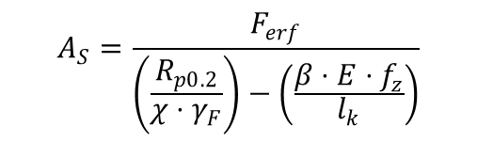
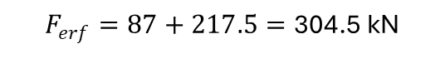

Summation of axial components = $97.15+3.23$=100.38
Force required to prevent slip under shear load.
$$F_{KL}=\frac{F_{Q}}{μ_{T}}=\frac{87 }{0.4}=\text{217.5 }\text{kN}$$
Sum of Axial Design Load and Clamping Force
$$F_{erf}=F_{B}+F_{KL}$$
$$F_{erf}=87+217.5=\text{304.5 }\text{kN}$$
Stress area calculation
$$A_{S}=\frac{F_{erf}}{\left(\frac{R_{p0.2}}{χ⋅γ_{F}}\right)−\left(\frac{β⋅E⋅f_{z}}{l_{k}}\right)}$$
$$A_{S}≈578.79 {\text{mm}}^{2}$$
Source: Machinery components lectures

Slide 9
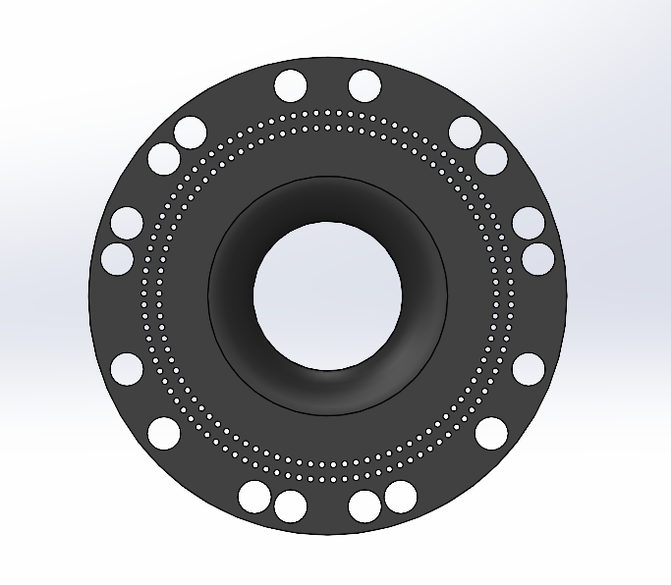
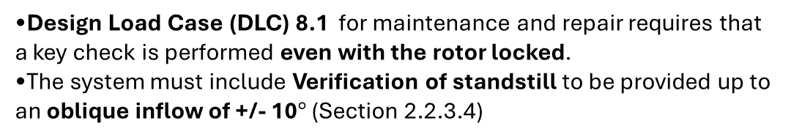
Rotor Lock Disc
Case 1 e1
Design Load Case (DLC) 8.1 for maintenance and repair requires that a key check is performed even with the rotor locked.
The system must include Verification of standstill to be provided up to an oblique inflow of +/- 10$°$ (Section 2.2.3.4)
Blade & Reference Angle | 1-pin Angle | 2-pin Angle
1st Blade (0∘) | 10∘ | 170∘
2nd Blade (0∘) | 250∘ | 50∘
3rd Blade (0∘) | 130∘ | 290∘
1st Blade (90∘) | 280∘ | 80∘
2nd Blade (90∘) | 40∘ | 200∘
3rd Blade (90∘) | 160∘ | 320∘
1st Blade (270∘) | 100∘ | 260∘
2nd Blade (270∘) | 220∘ | 20∘
3rd Blade (270∘) | 340∘ | 140∘
*Value we assigned based on our assumption
Divyesh Mistry
Source: GL 2010 & LLM(Large Language Models).

Slide 10
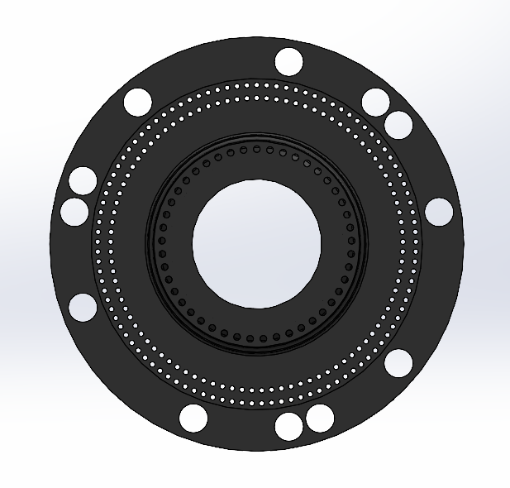
Rotor Lock Disc
Case 2 e1
Design Load Case (DLC) 8.1 for maintenance and repair requires that a key check is performed even with the rotor locked.
The system must include Verification of standstill to be provided up to an oblique inflow of +/- 10$°$ (Section 2.2.3.4)
Blade & Reference Angle | 1-pin Angle | 2-pin Angle
1st Blade (0∘) | 10∘ | 170∘
2nd Blade (0∘) | 250∘ | 50∘
3rd Blade (0∘) | 130∘ | 290∘
1st Blade (90∘) | 280∘ | 80∘
2nd Blade (90∘) | 40∘ | 200∘
3rd Blade (90∘) | 160∘ | 320∘
*Value we assigned based on our assumption
Divyesh Mistry
Source: GL 2010 & LLM(Large Language Models).

Slide 11
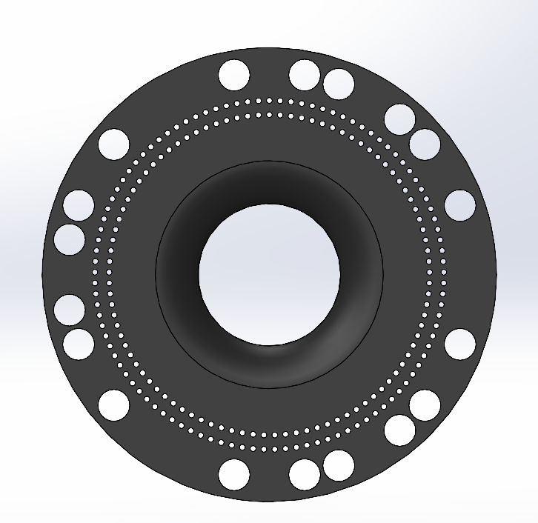
Rotor Lock Disc
Case 3 e1
Design Load Case (DLC) 8.1 for maintenance and repair requires that a key check is performed even with the rotor locked.
The system must include Verification of standstill to be provided up to an oblique inflow of +/- 10$°$ (Section 2.2.3.4)
Main Position | Hole A (−10∘) | Hole B (+10∘)
0∘ | 350∘ | 10∘
30∘ | 20∘ | 40∘
90∘ | 80∘ | 100∘
120∘ | 110∘ | 130∘
150∘ | 140∘ | 160∘
210∘ | 200∘ | 220∘
240∘ | 230∘ | 250∘
270∘ | 260∘ | 280∘
330∘ | 320∘ | 340∘
*Value we assigned based on our assumption
Divyesh Mistry
Source: GL 2010 & LLM(Large Language Models).

Slide 12
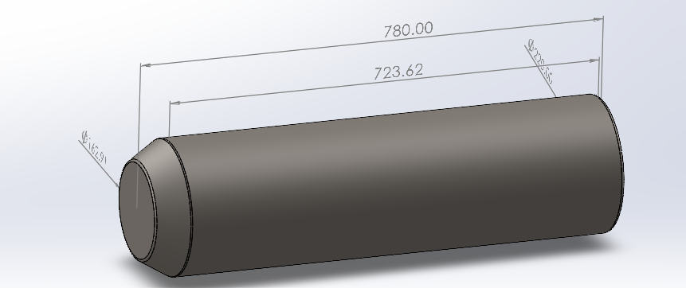
Rotor Lock Pin
parameter | value | unit
L1 | 723,68 | mm
L2 | 56,38 | mm
D1 | 220 | mm
D2 | 162 | mm
L2
D1
D2
L1

Slide 13
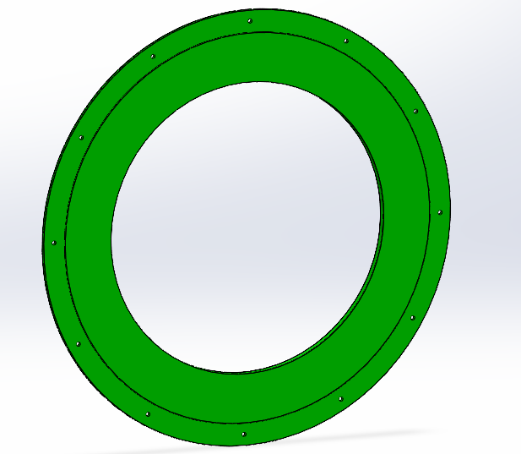
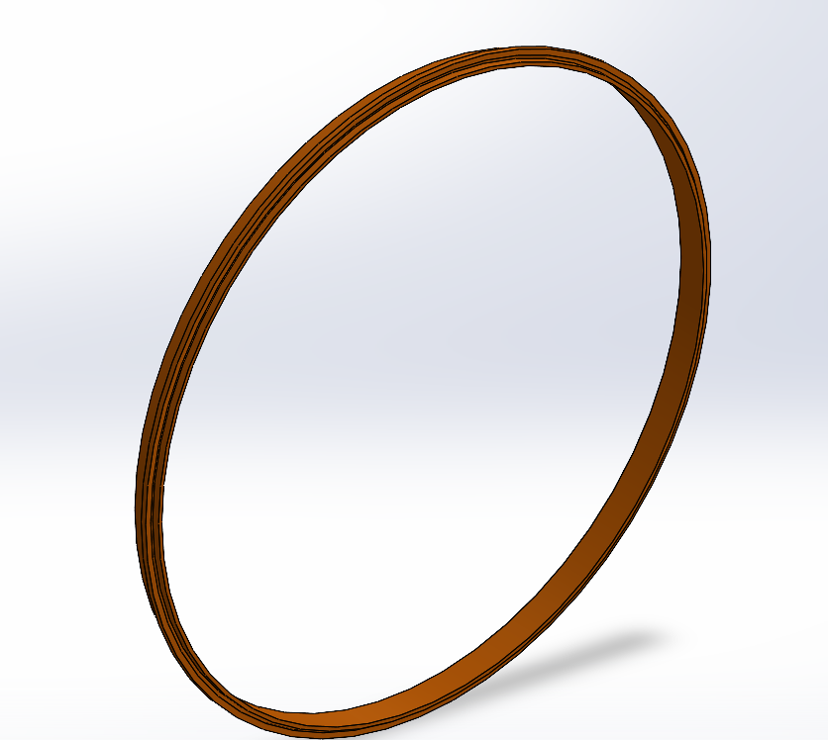
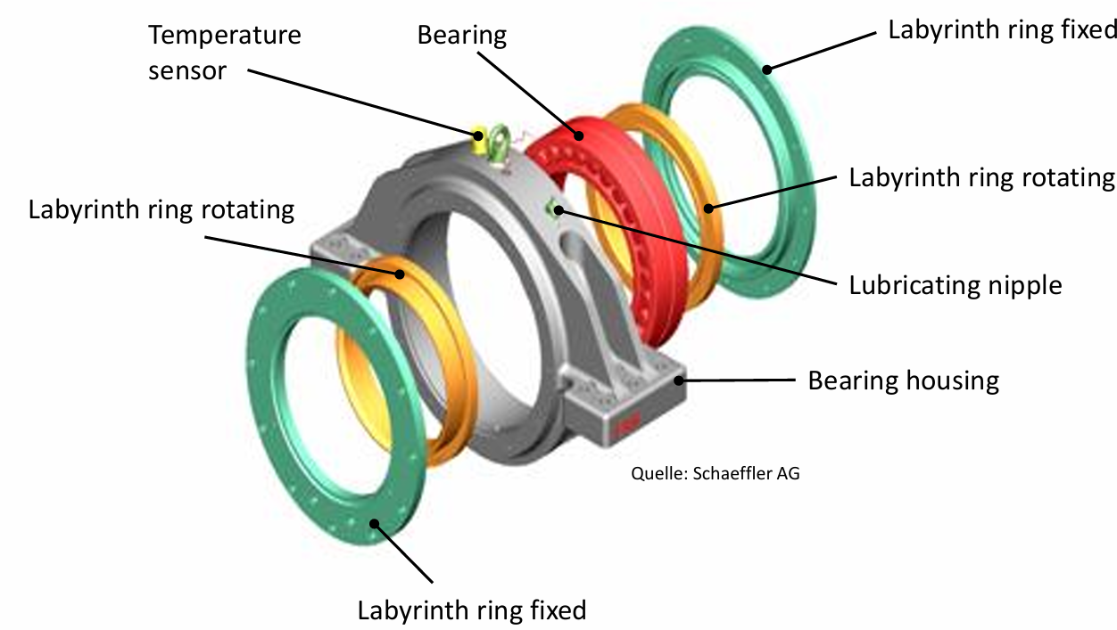
Labyrinth Sealing
Labyrinth ring fixed
Labyrinth ring rotating

Slide 14
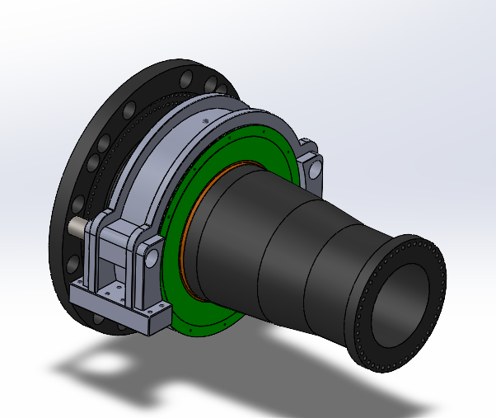
Rotor Bearing Assembly
Divyesh Mistry

Slide 15
Cost Calculation(Assumption)
Washer Size | Germany – Typical Retail Price (€ per piece)
M36 (DIN125 – 37×66×5 mm) | 0.31 – 2.08
M42 (DIN125 – 43×78×7 mm) | 1.57 – 2.82
M48 (DIN125 – 50×92×8 mm) | 2.16 – 12.75
Bolt Specification | Quantity | Single-Piece Retail Price (Average Estimate) | Total Retail Cost (Estimated)
M36 × 200 | 196 | €80.00 | €15,680.00
M42 × 250 | 24 | €85.00 | €2,040.00
M48 × 200 | 46 | €40.00 | €1,840.00
TOTAL | 266 bolts |  | €19,560.00
Divyesh Mistry

Slide 16
Bibliography – Rotor Bearing System
Optimus Shakti, Optimus 60E
ITH. (n.d.). ITH Hydraulic Torque Wrenches Catalog. Retrieved November 08, 2025, from www.ITH.de/schraubwerkzeuge/hydraulische-drehmomentschrauber
DIN EN 10083-3: Steels for quenching and tempering – Part 3: Technical delivery conditions for alloy steels. Retrieved November 22, 2025, from https://studylib.net/doc/18166049/din-en-10083-steel-for-quenching-and-tempering-part-3-
American Institute of Steel Construction. (1989). Manual of Steel Construction: Allowable Stress Design (9th ed.). Chicago, IL: Author. Retrieved November 22, 2025, from Internet Archive (Manual of Steel Construction: Allowable Stress Design, 9th Edition)
LLM(Large Language Models).
Germanischer Lloyd Industrial Services GmbH, Renewables Certification. (2010). Guideline for the certification of wind turbines.
Boltport Fasteners. (n.d.). DIN 125 Flat Washers Weights Chart. Retrieved December 8, 2025, from https://boltport.com/weights/din-125/
M. Wilhelmsen A/S. (n.d.). STEEL BOLT M48X240 10.9 DIN 931. Abgerufen am 8. Dezember 2025, von https://ehandel.mw.dk/en/steel-bolts-din-931/steel-bolt-m48-109
Divyesh Mistry

